Slide 1

Machine learning detection of cancer in liquid biopsies
Pascal Bärtschi & Alina Martin
BME330 Quantitative Biomedicine
15.11.2022

Slide 2
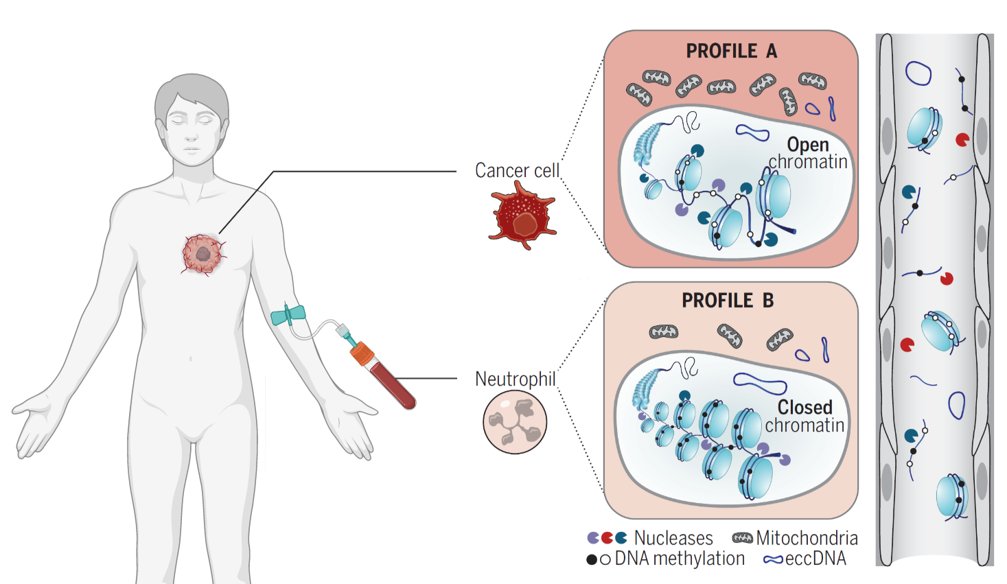
cfDNA - a useful biomarker in cancer care
Released by cells undergoing cell death
Healthy patients 60-90% from hematopoietic cells
→ What information can we get from cfDNA?
https://doi.org/10.1126/science.aaw3616
Notes:
- Short double-stranded DNA fragments
In Plasma & other bodily fluids
Cells undergoing cell death
Healthy: 60-90% from hematopoietic

Slide 3
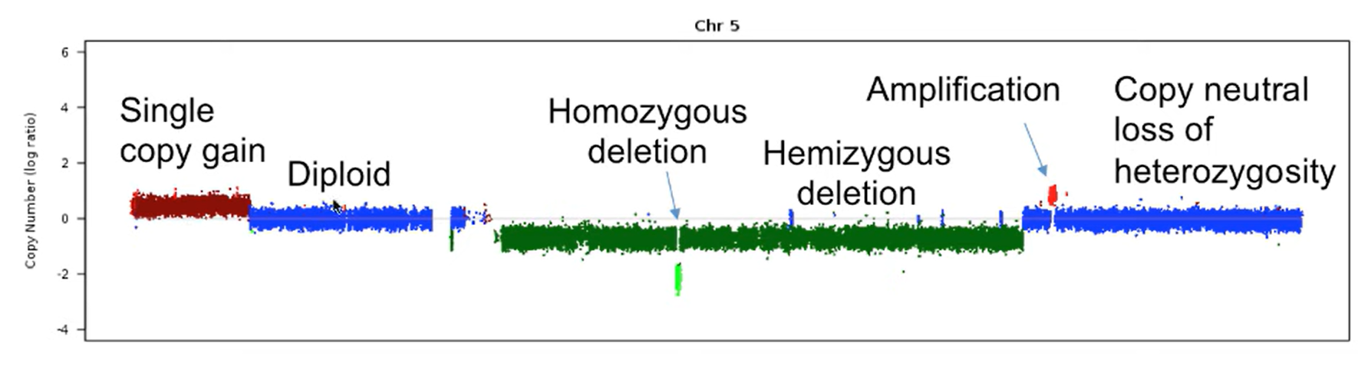
Detection of tumor-specific genetic variation
Somatic mutations
Copy number alterations (CNAs)
→ Identification of tumour type and monitoring its evolution
Copy Number (log2 ratio)
Bioinformatics for Cancer Genomics 2017
Notes:
- Previous and ongoing approaches: detection of tumor-specific genetic variation.
Gain or loss of gene segments
Loss of tumour suppressor genes
Analysis allows to identify the tumour type and monitor its evolution.

Slide 4
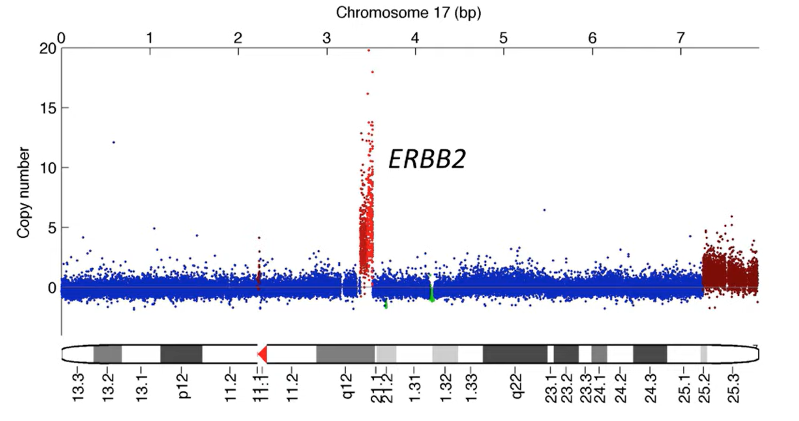
Genes known to be affected by somatic CNAs
Amplifications
ERBB2, EGFR, MYC, PIK3CA, IGF1R, FGFR1/2, KRAS, CDK2, CDK6
Deletions
RB1, PTEN, CDKN2A/B, ARID1A, MAP2K4, NF1, SMAD4, BRCA1/2, MSH2/6, CDH1
ERBB2 = proto-oncogene
Bioinformatics for Cancer Genomics 2017
Notes:
Genes known to be affected by CNS
ERBB2: oncogene, amplification in breast cancer
However, not all tumours carry CNA

Slide 5

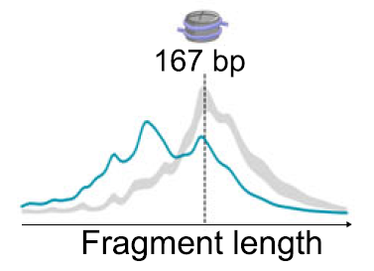
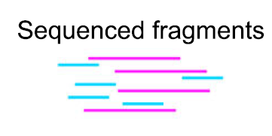
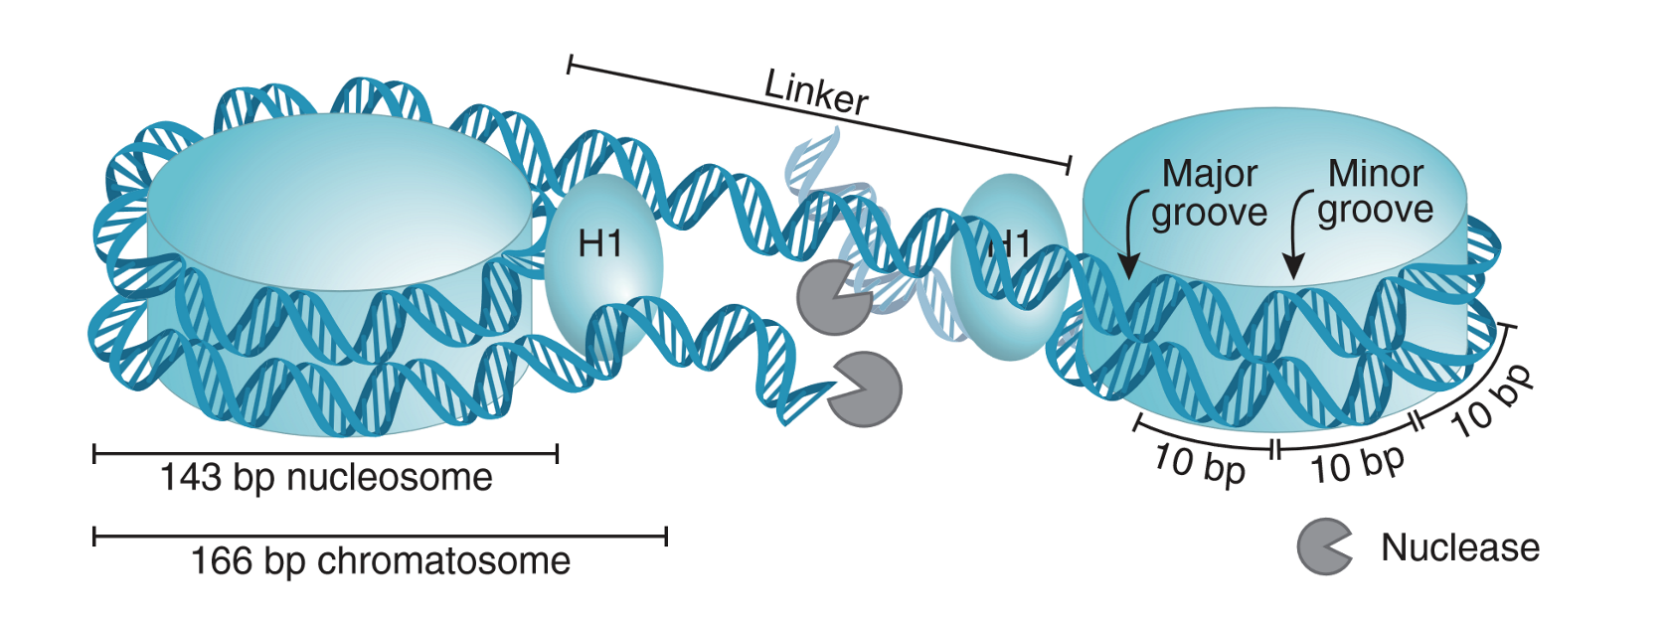
cfDNA is wrapped around nucleosomes
Protection from degradation by nucleases
Tumour cfDNA fragments are shorter than the ones from healthy cells
https://doi.org/10.1038/s41467-021-23445-w
https://doi.org/10.1126/science.aaw3616
Notes:
Size of cfDNA fragments varies
Mode is around 166bp
Tumour fragments are shorter

Slide 6
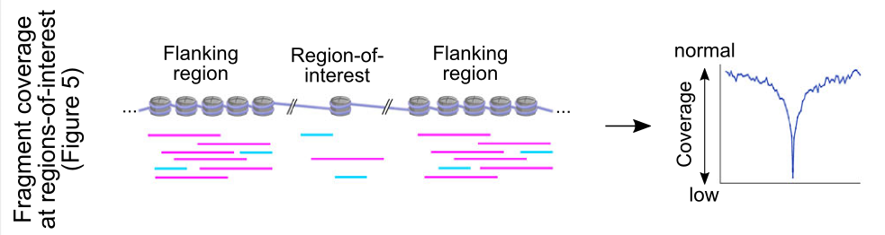
Fragmentation pattern reflects the nucleosome positions of the cell of origin
Nucleosome footprint provides information about origin of the tumour
Highly expressed genetic regions have decreased coverage in cfDNA
https://doi.org/10.1038/s41467-021-23445-w
Notes:
Gain knowlege about the origin
Fragmentation pattern reflects nucleosmoe positions in cell of origin
Nucleosome footprint (WPS = Window protection score: fragments inside the window – cells not inside)
Specific regions, like promotor sites
Open chromatin, no protection
Decreased coverage

Slide 7
Summary
cfDNA allows us to distinguish healthy from cancer cells and gives us information about the origin and the evolution of a tumour
This allows the implementation into targeted therapy
Notes:
Sum up: distinguish healthy from sick, origin, evolution, targeted therapy

Slide 8
Projects’ approach nodes
→ Combining theoretical and conceptual knowledge and apply it to build and answer research question
Theory
&
Concepts
Application
Notes:
Theory -> tumour specific cfDNA changes
Application -> distinguishing healthy from cancer patients, classify into cancer type
3 approaches to diversify this connection

Slide 9
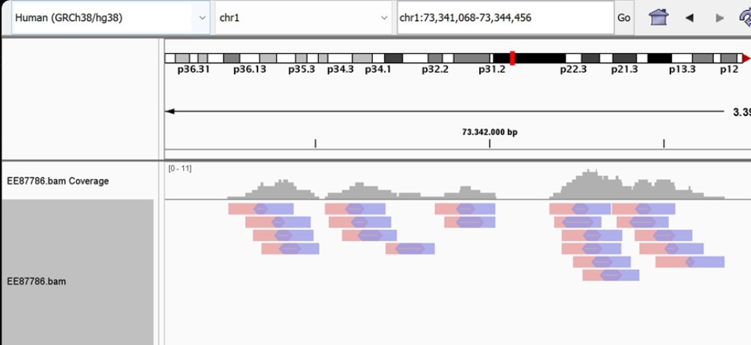
Data
WGS data stored in BAM files of cohorts
262 healthy
79 lung cancer
53 breast cancer
35 cancer A
25 cancer B
Coverage ranges 1x – 10X
Source: Cristiano et. al 2019
Notes:
Cancer A, B: our project to identify cancer types based on characteristics
Bp coverage / sample
Genome-wide cell-free DNA fragmentation in patients with cancer -> similar results, extra
Remember : highly expressed regions are less/NOT covered by nucleosomes, gain function

Slide 10
Projects’ approach nodes I
→ Combining theoretical and conceptual knowledge and apply it to answer research question
Fragment length distribution
cfDNA
change
Classification
Notes:
Extract tumour origin out of footprint knowledge

Slide 11
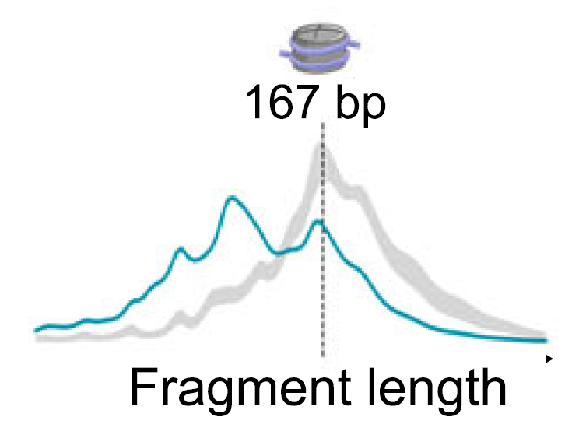
Fragment length density
Mouilllieres et al 2018
Notes:
Threshold 167bp

Slide 12
Projects’ approach nodes II
→ Combining theoretical and conceptual knowledge and apply it to answer research question
Fragment length distribution
cfDNA
change
Classification
Somatic CNA
Notes:
Extract tumour specific oncogenes out of footprint knowledge

Slide 13
IchorCNA
ichorCNA is an R tool for estimation of tumor fractions in ultra-low pass whole genome sequencing (WGS) and prediction of large-scale copy number variation (CNV)
Notes:
CNV info enables CNA detection

Slide 14
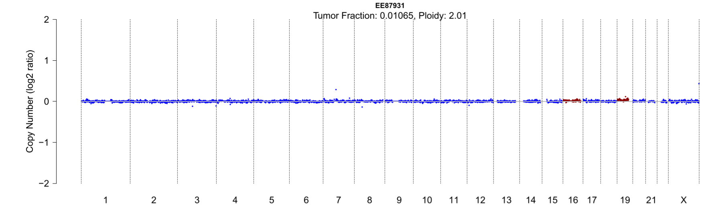
IchorCNA
→ ichorCNA is an R tool for estimation of tumor fractions in ultra-low pass whole genome sequencing (WGS) and prediction of large-scale copy number variation (CNV)

Slide 15
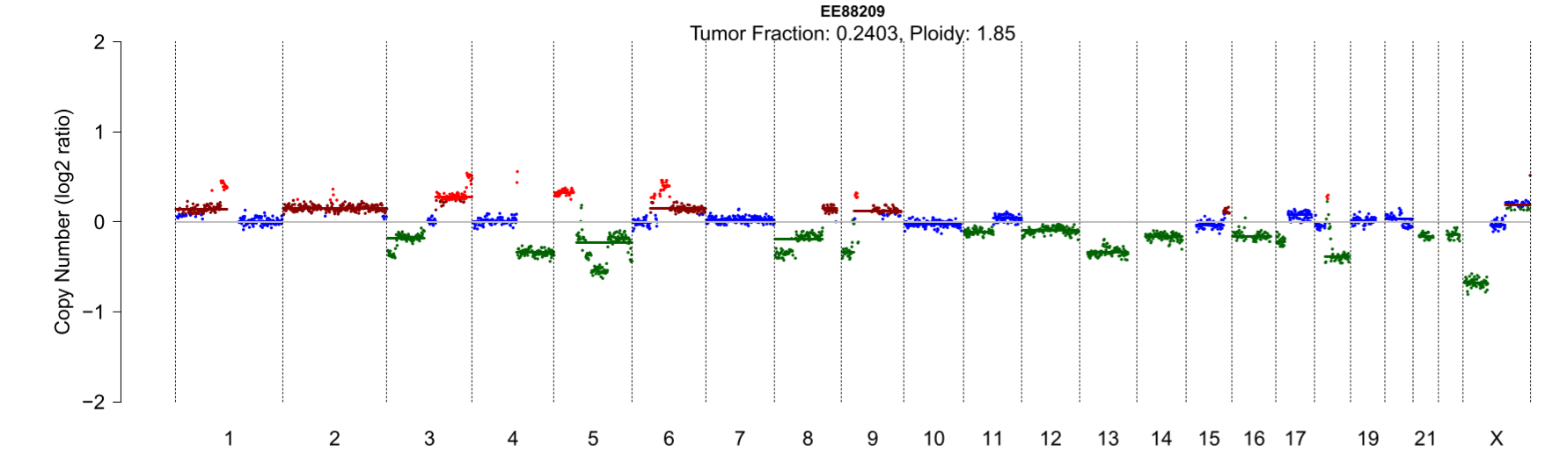
IchorCNA
→ ichorCNA is an R tool for estimation of tumor fractions in ultra-low pass whole genome sequencing (WGS) and prediction of large-scale copy number variation (CNV)
Notes:
Log2 ratio: CN sample, coverage / CN, average coverage
Focus on red: amplifications → CNAs → specific oncogenes → tumour type
Long arm

Slide 16
Projects’ approach nodes III
→ Combining theoretical and conceptual knowledge and apply it to answer research question
Fragment length distribution
cfDNA
change
Classification
Somatic CNA
Nucleosome footprint
Notes:
Extract tumour origin out of footprint knowledge

Slide 17
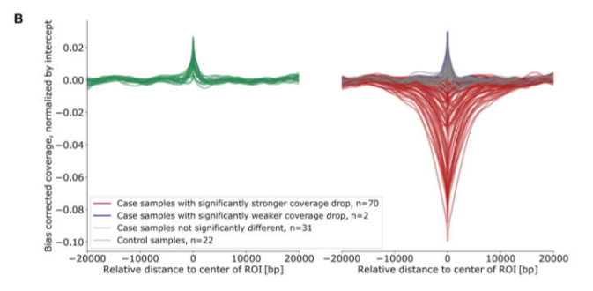
LIQUORICE
→ LIQUORICE is a software tool that takes aligned whole-genome sequencing data as input and calculates bias-corrected coverage signatures for predefined, application-specific sets of genomic regions.
Peneder et al. 2022
Notes:
Computes nucleosome coverage genomic regions
Region of interest:
Compare green to red
Coverage drop: enhanced promotors due to oncogenes are in euchromatin region, healthy in closed chromatin
→ Tumour origin

Slide 18
Projects’ approach nodes IV
→ Combining theoretical and conceptual knowledge and apply them to build and answer research question
Dataset
Bioinformatics
Machine Learning
WGS BAM files
Length density
ichorCNA
LIQUORICE
→ Features, Structured Data
Handles dense data
Classification
→ Answer to Research Question
Notes:
Dataset
WGS from liquid biopy (where from?)
No SNP detection, no identification
Bioinformatics:
Liquorice
Ichor CAN
Machine Learning
Features of cfDNA
Random forrest, SVs, regression appoaches

Slide 19
Research Question
→ Combining theoretical and conceptual knowledge and apply them to build and answer research question
Question: Can machine learning distinguish healthy from cancer samples, and if yes, can it even distinguish different cancer types?
Prediction: Machine learning is capable of such distinction. (Liu et al. 2021)

Slide 20
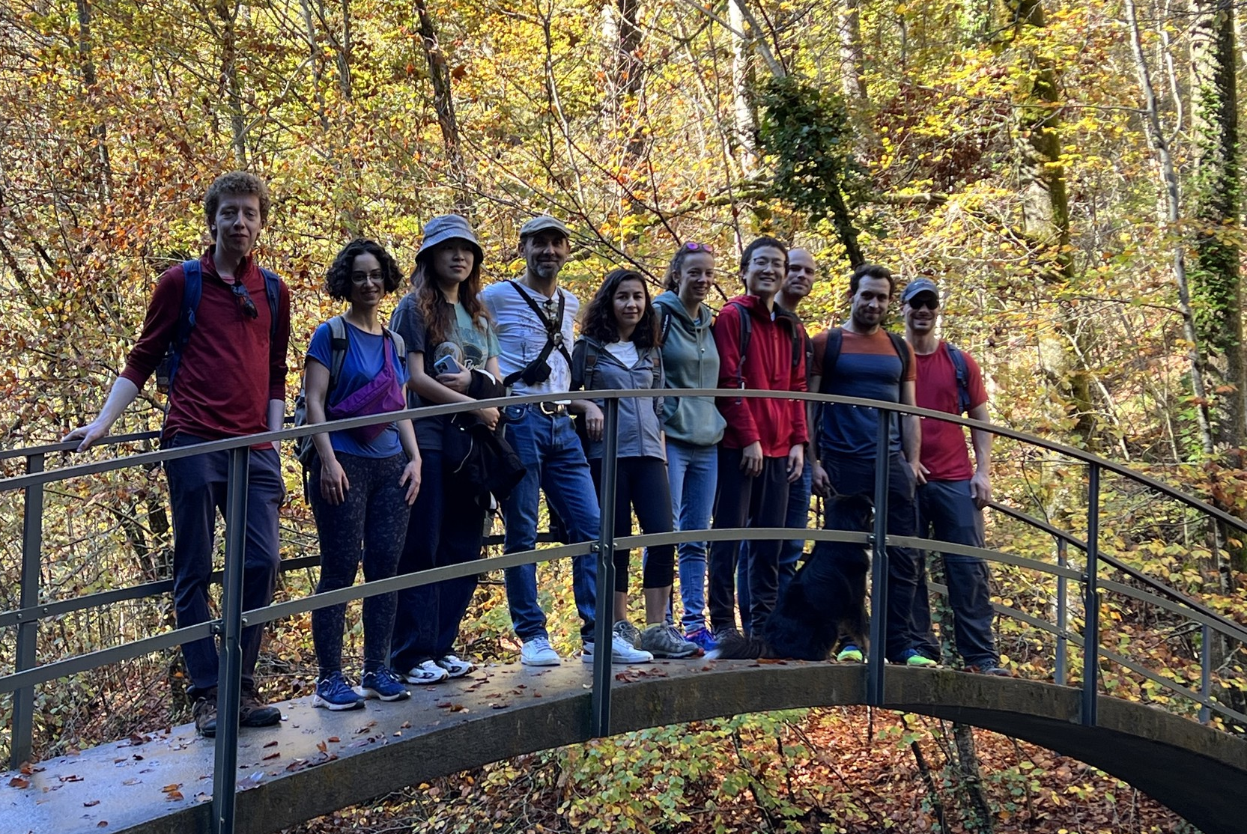
Acknowledgements

Slide 21
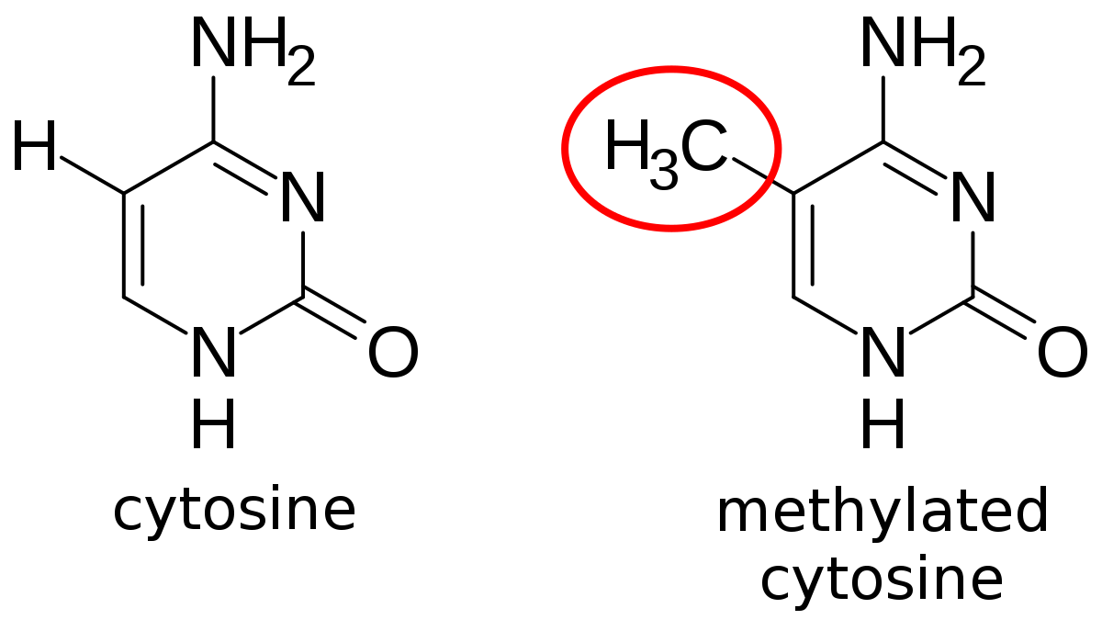
DNA methylation status
Tumour suppressor genes are often hypermethylated
DNA methylation is tissue-specific: Interesting in the case of cancers of unknown primary
https://commons.wikimedia.org/w/index.php?curid=54317915
Notes:
Tumor suppressor genes often hypermethylated → healthy vs sick
Tissue-specific → cell of origin
Cancer of unknown primary
Sum up: distinguish healthy from sick, origin, evolution, targeted therapy

Slide 22
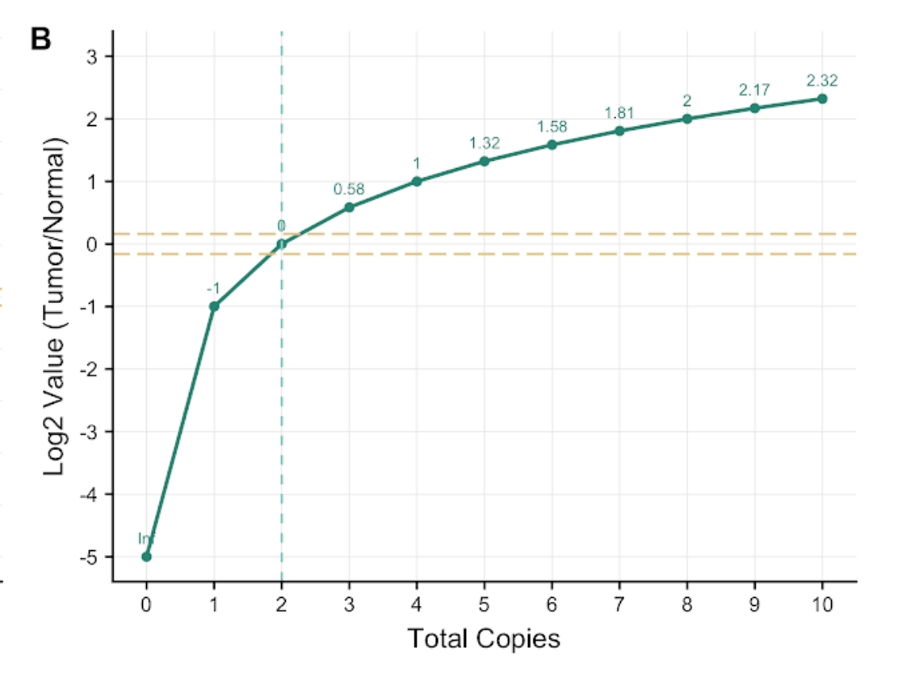
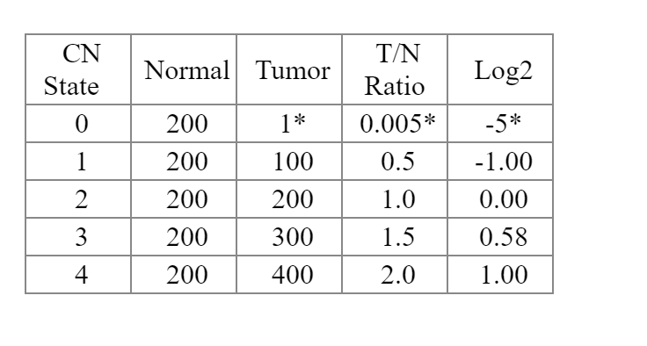
Log2 ratio
Here normal ploidy = 2
https://www.keatslab.org/blog/dnacopynumberanditseffectsonlog2valuesandallelicratiosatdifferenttumorpurities

